Slide 1
inline PHY acceleration: a GPU based framework
05/07/2020

Slide 2
purpose
To illustrate C-plane and U-plane data flows for GPU based inline PHY acceleration architecture.

Slide 3
agenda
GPU based inline PHY acceleration architecture.
C-plane and U-plane data flow in uplink.
C-plane and U-plane data flow in downlink.
Direct communication between GPU and NIC.
Proposal.

Slide 4
Control and user plane data flow (Uplink)
L2 initiates PHY layer processing in UL by sending UL Config. request to L1 controller on CPU.
L1 controller encapsulates (eCPRI) and sends C-plane packets to O-RU.
In response, O-RU sends U-plane packets over fronthaul, which are directly stored in the GPU.
The received packets on U-plane are out-of-order in the GPU mempool.
A CUDA kernel on the GPU is tasked with “data placement”, which essentially reorders the data packets in contiguous input buffer.
Once all packets are ordered, data placement kernel quits, and UL PHY processing is initiated on CUDA stream on the GPU.
Post PHY processing, the output is returned from the GPU output buffer to the upper layer (L2) on CPU using GPU→CPU memory copy.
C-plane and U-plane data flow in UL (PUSCH as example)

Slide 5
Control and user plane data flow (downlink)
L2 initiates PHY layer processing in DL by sending DL Config. request to L1 controller on CPU.
L1 initiates DL data pipeline on CUDA stream on the GPU.
The DL output buffer holding the processed data from DL PHY pipeline resides in the GPU memory.
L1 generates O-RAN formatted (eCPRI) C-plane packets in the CPU and send to O-RU.
U-plane data from DL output buffer are framed into O-RAN compliant packets in GPU DPDK mempool and are directly sent from the GPU to NIC, symbol-by-symbol.
C-plane and U-plane data flow in DL

Slide 6
Background: GPU DPDK
DPDK features
Mbuf
Mbuf library provides ability to allocate/free buffers (mbufs) by DPDK to store data packets.
Each mbuf has a header part (metadata) and a payload part (content).
DPDK usually embeds metadata within a single memory buffer, followed by a fixed size area for the payload (e.g. packet data).
Mbufs are stored in mempool within host memory, using Mempool library.
GPU DPDK*
Conventional DPDK mempool is not suitable.
Mbufs reside in host (CPU) memory, not directly visible/accessible from GPU.
Solution: use of separate memory buffers for mbufs’ metadata and payload.
Feature introduced since DPDK v18.05.
Payload resides in an external memory area with respect to the header.
*https://developer.download.nvidia.com/video/gputechconf/gtc/2019/presentation/s9730-packet-processing-on-gpu-at-100gbe-line-rate.pdf

Slide 7
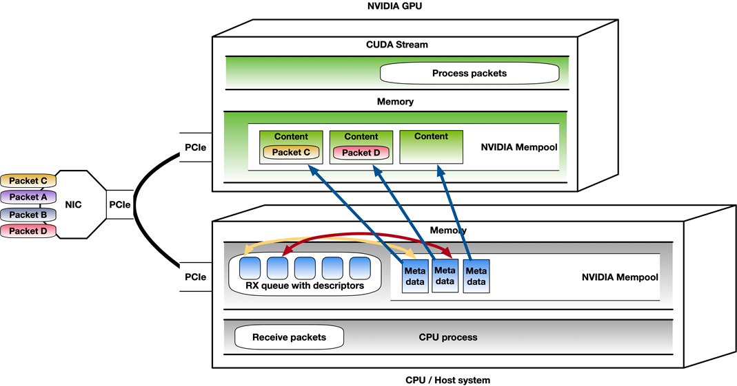
GpU ↔ nic direct communication
GPU and NIC are connected to the same PCIe root complex.
Rx queue is created by the application in the CPU (host) memory.
NIC creates descriptors in the Rx queue to inform the application of new data arrival in UL.
GPU DPDK embeds metadata and packet payload in separate mbufs:
Metadata is placed in CPU memory.
Payload/data packets are placed directly in the GPU memory using GPUDirect RDMA*.
Post re-ordering, data packets stored in GPU memory buffer are processed through UL PHY pipeline on CUDA streams.
In DL, post PHY processing, the IQ data is encapsulated with O-RAN header and sent directly from GPU memory to NIC.
GPU ↔ NIC data communication GPUDirect RDMA + GPU DPDK
* https://docs.nvidia.com/cuda/gpudirect-rdma/index.html

Slide 8
Proposal
Consider GPU based inline acceleration framework in defining common interface functions for O-RAN AAL API.

